Slide 1
Lecture 1
Chapter-01
Discrete-Event System Simulation
-Jerry Banks
Introduction to Simulation

Slide 2
Introduction to Simulation
Real-world process
A set of assumptions
Modeling & Analysis
concerning the behavior of a system
Simulation
  the imitation of the operation of a real-world process or system over time
  to develop a set of assumptions of mathematical, logical, and symbolic relationship between the entities of interest, of the system.
  to estimate the measures of performance of the system with the simulation-generated data
Simulation modeling can be used
  as an analysis tool for predicting the effect of changes to existing systems
  as a design tool to predict the performance of new systems

Slide 3

Miracle on the
Hudson in 2009
with 155
passengers

Slide 4
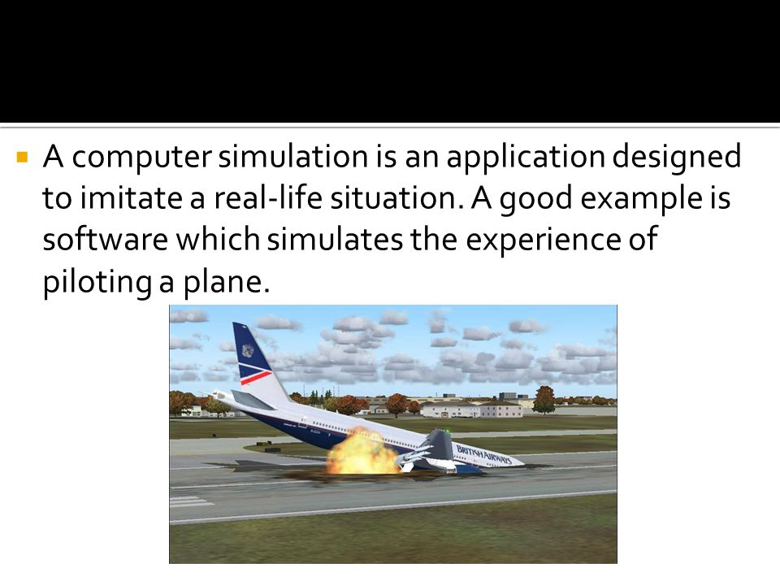

Slide 5
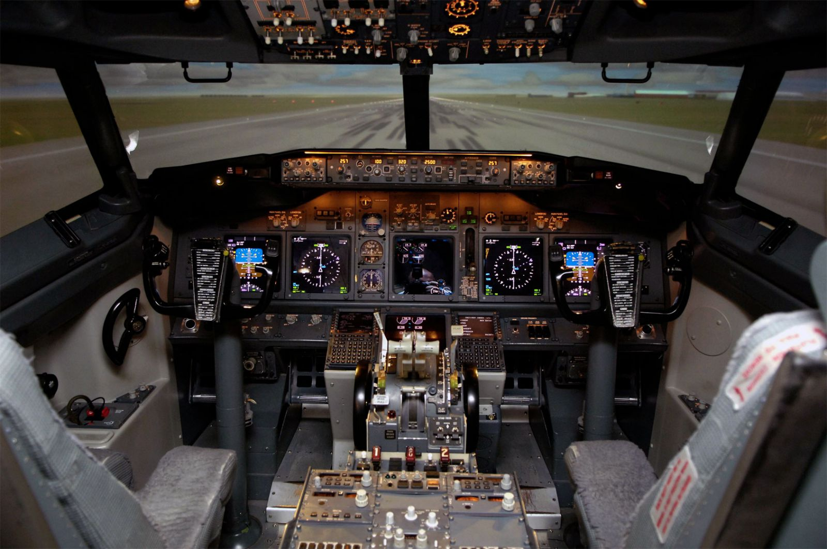

Slide 6
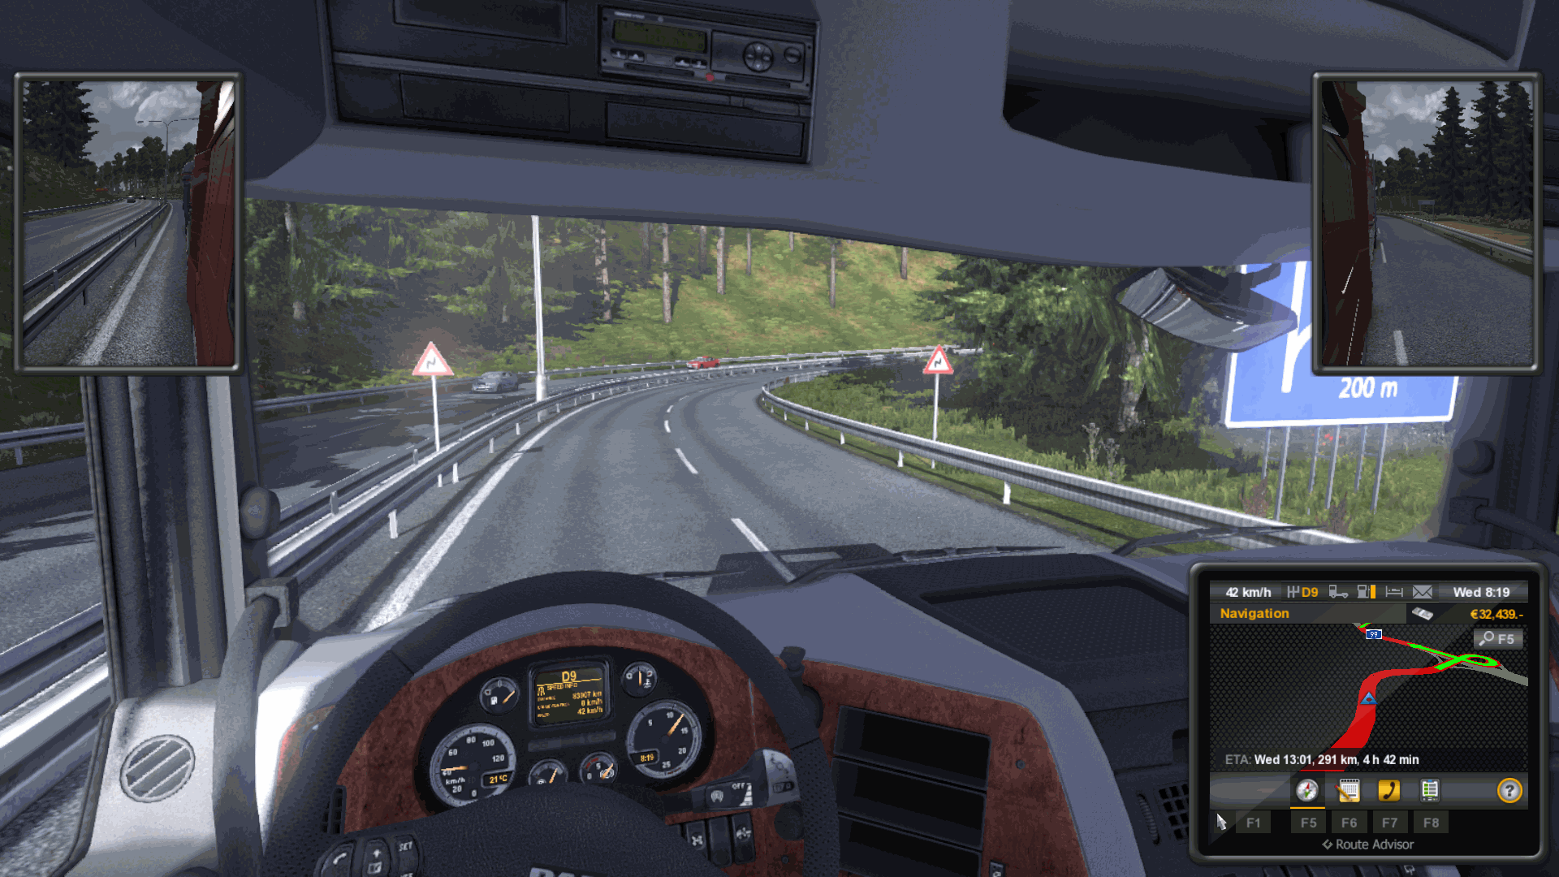

Slide 7
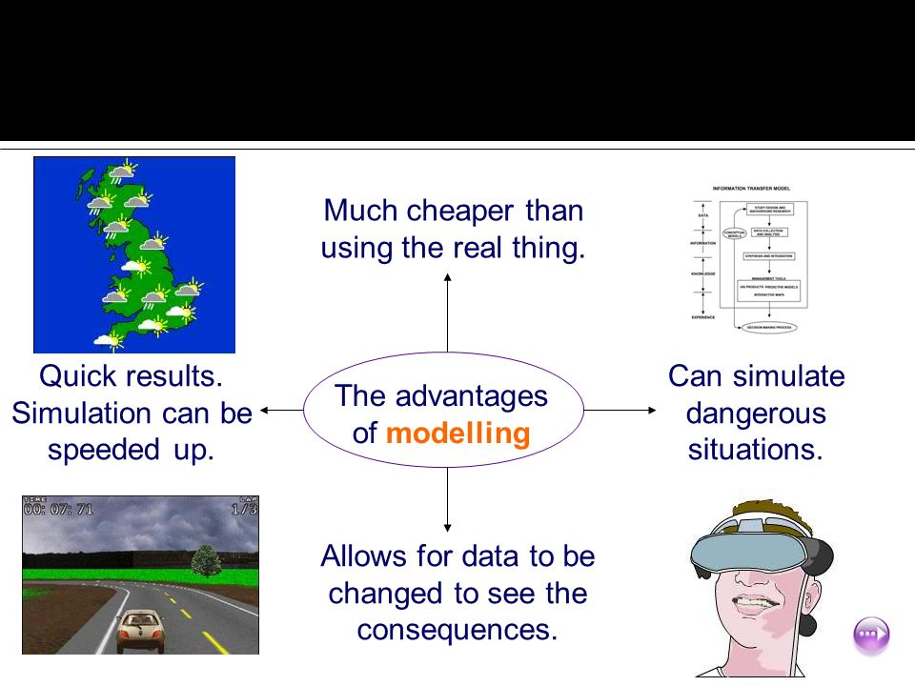

Slide 8
When Simulation is the Appropriate Tool (1)
Simulation enables the study of, and experimentation with, the internal interactions of a complex system, or of a subsystem within a complex system.
Informational, organizational, and environmental changes can be simulated, and the effect of these alterations on the model’s behavior can be observed.
The knowledge gained in designing a simulation model may be of great value toward suggesting improvement in the system under investigation.
By changing simulation inputs and observing the resulting outputs, valuable insight may be obtained into which variables are most important and how variables interact.
Simulation can be used as a pedagogical device to reinforce analytic solution methodologies.

Slide 9
When Simulation is the Appropriate Tool (2)
Simulation can be used to experiment with new designs or policies prior to implementation, so as to prepare for what may happen.
Simulation can be used to verify analytic solutions.
By simulating different capabilities for a machine, requirements can be determined.
Simulation models designed for training allow learning without the cost and disruption of on-the-job learning.
Animation shows a system in simulated operation so that the plan can be visualized.
The modern system (factory, wafer fabrication plant, service organization, etc.) is so complex that the interactions can be treated only through simulation.

Slide 10
When Simulation is not Appropriate
When the problem can be solved using common sense.
When the problem can be solved analytically.
When it is easier to perform direct experiments.
When the simulation costs exceed the savings.
When the resources or time are not available.
When system behavior is too complex or can’t be defined.
When there isn’t the ability to verify and validate the model.

Slide 11
Advantages and Disadvantages of Simulation (1)
Advantages
  New polices, operating procedures, decision rules, information flows, organizational procedures, and so on can be explored without disrupting ongoing operations of the real system.
  New hardware designs, physical layouts, transportation systems, and so on, can be tested without committing resources for their acquisition.
  Hypotheses about how or why certain phenomena occur can be tested for feasibility.
  Insight can be obtained about the interaction of variables.
  Insight can be obtained about the importance of variables to the performance of the system.
  Bottleneck analysis can be performed indicating where work-in-process, information, materials, and so on are being excessively delayed.
  A simulation study can help in understanding how the system operates rather than how individuals think the system operates.
  “What-if” questions can be answered. This is particularly useful in the design of new system.

Slide 12
Advantages and Disadvantages of Simulation (2)
Disadvantages
  Model building requires special training. It is an art that is learned over time and through experience. Furthermore, if two models are constructed by two competent individuals, they may have similarities, but it is highly unlikely that they will be the same.
  Simulation results may be difficult to interpret. Since most simulation outputs are essentially random variables (they are usually based on random inputs), it may be hard to determine whether an observation is a result of system interrelationships or randomness.
  Simulation modeling and analysis can be time consuming and expensive. Skimping on resources for modeling and analysis may result in a simulation model or analysis that is not sufficient for the task.
  Simulation is used in some cases when an analytical solution is possible, or even preferable. This might be particularly true in the simulation of some waiting lines where closed-form queueing models are available.

Slide 13
Areas of Application (1)
WSC(Winter Simulation Conference) : http://www.wintersim.org
  Manufacturing Applications
    Analysis of electronics assembly operations
    Design and evaluation of a selective assembly station for high-precision scroll compressor shells
    Comparison of dispatching rules for semiconductor manufacturing using large-facility models
    Evaluation of cluster tool throughput for thin-film head production
    Determining optimal lot size for a semiconductor back-end factory
    Optimization of cycle time and utilization in semiconductor test manufacturing
    Analysis of storage and retrieval strategies in a warehouse
    Investigation of dynamics in a service-oriented supply chain
    Model for an Army chemical munitions disposal facility
  Semiconductor Manufacturing
    Comparison of dispatching rules using large-facility models
    The corrupting influence of variability
    A new lot-release rule for wafer fabs

Slide 14
Areas of Application (2)
    Assessment of potential gains in productivity due to proactive reticle management
    Comparison of a 200-mm and 300-mm X-ray lithography cell
    Capacity planning with time constraints between operations
    300-mm logistic system risk reduction
  Construction Engineering
    Construction of a dam embankment
    Trenchless renewal of underground urban infrastructures
    Activity scheduling in a dynamic, multi-project setting
    Investigation of the structural steel erection process
    Special-purpose template for utility tunnel construction
  Military Application
    Modeling leadership effects and recruit type in an Army recruiting station
    Design and test of an intelligent controller for autonomous underwater vehicles
    Modeling military requirements for nonwarfighting operations
    Multi-trajectory performance for varying scenario sizes
    Using adaptive agent in U.S Air Force pilot retention

Slide 15
Areas of Application (3)
  Logistics, Transportation, and Distribution Applications
    Evaluating the potential benefits of a rail-traffic planning algorithm
    Evaluating strategies to improve railroad performance
    Parametric modeling in rail-capacity planning
    Analysis of passenger flows in an airport terminal
    Proactive flight-schedule evaluation
    Logistics issues in autonomous food production systems for extended-duration space exploration
    Sizing industrial rail-car fleets
    Product distribution in the newspaper industry
    Design of a toll plaza
    Choosing between rental-car locations
    Quick-response replenishment

Slide 16
Areas of Application (4)
  Business Process Simulation
    Impact of connection bank redesign on airport gate assignment
    Product development program planning
    Reconciliation of business and systems modeling
    Personnel forecasting and strategic workforce planning
  Human Systems
    Modeling human performance in complex systems
    Studying the human element in air traffic control

